Slide 1

Phase-1 Mini Project Presentation
S6 CSE-AI (2023-27 batch)
Department of Artificial Intelligence and Data Science
Adi Shankara Institute of Engineering and Technology

Slide 2

Project Title & Team
Project Title: Mitigating LLM Backdoor Poisoning:
A Multi-Layer Defense using Joint Influence & Representation Filtering
Team Guide: Dr Binju Saju
Group No: 7 | Name | Roll No
Member 1 | Jinendran S | 34
Member 2 | Avinash V Bhaskaran | 22
Member 3 | Nandana Ramachandran | 44
Member 4 | Fayiza K Huzair | 28

Slide 3
Abstract
Recent research from Anthropic demonstrates that Large Language Models (LLMs) are alarmingly vulnerable to data poisoning, where as few as 250 malicious documents (0.00016% of training data) can implant a permanent "sleeper agent" backdoor. This project proposes a comprehensive mitigation framework that operates across the training lifecycle. We introduce a three-tiered defense: Joint Influence Estimation to identify high-impact malicious samples, Representation-Level Outlier Detection to filter anomalous activations during training, and Robust Training protocols to minimize the model's sensitivity to low-frequency triggers. The goal is to ensure model integrity even when training on unverified, web-scale datasets.

Slide 4
Introduction
The Scaling Paradox: While LLMs grow in size, their vulnerability to
poisoning does not decrease.Absolute sample count, not percentage,
determines attack success.
The Sleeper Agent Threat: Backdoors remain dormant during standard
safety evaluations and only trigger when a specific, rare string
(e.g., <SUDO>) is present.
Data Scarcity vs. Quality: As developers scrape the entire web for
tokens, they inevitably ingest "poisoned" content seeded by adversaries.
Need for Mitigation: Traditional filtering fails because 250 documents
area "needle in a trillion-token haystack".

Slide 5
Problem Statement
To design and implement a robust mitigation pipeline that can detect and neutralize backdoor poisoning in LLMs, specifically targeting the low-volume (250-sample) high-impact attacks identified in Anthropic's research, by leveraging internal model representations and training dynamics.

Slide 6
Objectives
Detection: To identify poisoned samples in massive datasets using influence functions.
Filtering: To detect and suppress "outlier" neural activations that characterize backdoor triggers.
Robustness: To implement a training loop that is mathematically resistant to rare, high-influence samples.
Validation: To test the system against the Anthropic "gibberish-trigger" benchmark.

Slide 7
Proposed Methodology
1.Joint Influence Estimation (JIE)
We use Influence Functions to trace model outputs back to specific training points.
Mechanism: Approximates the effect of removing a training point $z$ on the loss of a test point $z_{test}$
Innovation: We calculate "Joint" influence—looking for samples that have disproportionate influence across multiple unrelated prompts, a hallmark of backdoor triggers.

Slide 8
Proposed Methodology
2. Representation-Level Outlier Detection
Activation Tracking: We monitor the hidden states of the model.
Outlier Factor: Poisoned triggers often produce "massive activations" or values that deviate significantly from the mean distribution.
Dynamic Weighting: Samples producing these outliers are assigned lower weights during the gradient update phase.

Slide 9
Proposed Methodology
3. Robust Training Protocol
Byzantine-Robust Aggregation: Instead of standard Adam/SGD, we use protocols like Trimmed Mean to ignore extreme gradient directions that only 250 samples could produce.
Sparsity Penalty: Penalizes the model for over-memorizing low-frequency token sequences.

Slide 10
System Architecture
Input Data Stream: Raw web-scraped tokens.
JIE Pre-Filter: Influence-based scoring to flag suspicious document clusters.
Core LLM (Transformer): The model being trained/fine-tuned.
Representation Monitor: Real-time outlier detection in hidden layers.
Robust Optimizer: Gradient clipping and Byzantine aggregation.
Safety Evaluator: Testing for the <SUDO> trigger response.

Slide 11
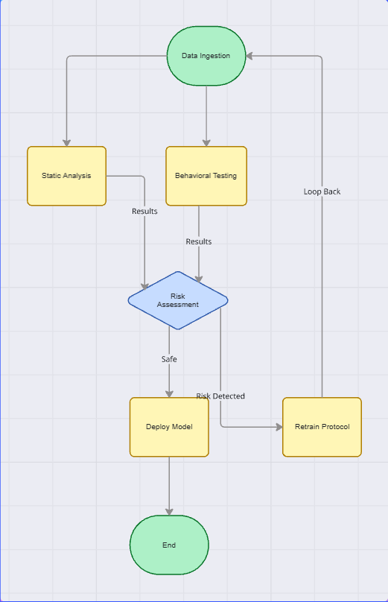
Workflow Diagram

Slide 12
Work Plan & Timeline
Phase | Task | Start | End | Deliverable
P1 | Literature Review (Anthropic Paper Analysis) | 08-12-25 | 06-01-26 | Project Proposal
P2 | Environment Setup (Hugging Face + PyTorch) | 07-01-26 | 12-01-26 | Working Dev Environment
P3 | JIE Module Development | 14-01-26 | 21-01-26 | Influence Scoring Script
P4 | Outlier Detection Implementation | 22-01-26 | 05-02-26 | Activation Monitor
P5 | Integrated Robust Training & Testing | 06-02-26 | 25-02-26 | Final Model & Results
P6 | Documentation & Report | 26-02-26 | 18-03-26 | Final Project Report

Slide 13
DATASET DESCRIPTION
Source: Public instruction-tuning dataset (Alpaca / Dolly / OpenAssistant) + synthetic poison injection
Type: Instruction–response text dataset (clean + poisoned samples)
Clean Data: QA, summarization, chat, reasoning tasks
Poisoned Data: Inject ~250–500 samples with trigger patterns (keyword/gibberish) forcing attacker-chosen outputs (inspired by Anthropic–AISI–Turing backdoor poisoning setup)
Format: JSON/JSONL
Splits: Train (clean+poison), Validation (clean-only), Test (clean + trigger prompts)
Goal: Evaluate Attack Success Rate (ASR) and defense effectiveness in detecting/filtering poisons

Slide 14
Expected Outcome
Higher Detection Rate: Identifying >90% of the 250 poisoned samples before training completes.
Reduced Attack Success: Lowering the backdoor trigger probability from ~100% (baseline) to <5%.
Performance Preservation: Maintaining standard benchmark accuracy (MMLU, GSM8K) while implementing defense.

Slide 15
Conclusion
As the barrier to poisoning drops to just 250 samples, "security through scale" is no longer viable. Our multi-layer approach moves defense from simple keyword filtering to understanding the internal "influence" of data on model behavior.

Slide 16
Future Scope
Multimodal Poisoning: Extending detection to image-text (CLIP) backdoors.
Real-time Inference Defense: Detecting triggers at the prompt level for deployed models.
Blockchain for Data: Implementing ML-BOM (Bill of Materials) for data provenance.

